Slide 1

Vision of Symphony Focus Outlet development
December’2020

Slide 2
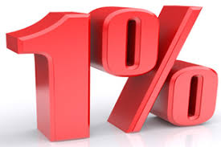
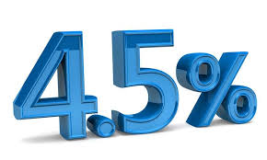
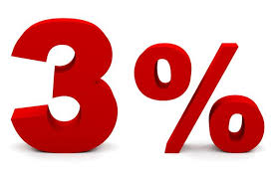
Objectives/Purpose
Ensure RETAIL business profitability by higher back margin strategy.
100% retail coverage and expand new outlet to ensure 100% mobile handset outlet business presence.
Retailers satisfaction & brand loyalty gain towards company.
Give equal importance of competitors branded close retail.
Now time to divert Competitors outlet.
Need Back Margin policy Proper channel understanding (Retail owner, Retail Sales person & Dealer & DSR).

Slide 3
Retail sales & incentive evalualtion_October’20
6353 SP outlets covered where we’ve scope 10K+ above in SP universe.
In 1249 SP sales outlet has zero bar phone sales
We provide BAR phone 2 taka but not covered all outlet by our DSR.
July Sales 170 cr where October only 120 cr.
At July we provide incentive 1.52 cr amount but October provide 1.82 cr
If we Sales 170 cr amount then we need to provide current policy incentive 2.58 cr which is 1.69% higher our previous expense.

Slide 4
Retail sales & incentive evalualtion_October’20
Region wise Target vs. Achievement % wise status
Region | 120% equal & above | >=100%- <120% | >=80%-<100% | >=50%-<80% | >=20%-<50% | <20% | Total
Chattogram | 15 | 26 | 105 | 47 | 87 | 77 | 357
Dhaka | 3 | 5 | 12 | 4 | 9 | 4 | 37
Dhaka North | 12 | 24 | 137 | 34 | 160 | 129 | 496
Dhaka South | 11 | 22 | 107 | 47 | 105 | 66 | 358
Khulna | 8 | 47 | 92 | 52 | 141 | 55 | 395
Rajshahi | 11 | 45 | 83 | 42 | 94 | 47 | 322
Rangpur | 2 | 17 | 43 | 27 | 91 | 55 | 235
Grand Total | 62 | 186 | 579 | 253 | 687 | 433 | 2200
Out of 2200 targeted retails, 38% (827) retail are achieved >=80%.
62% (1373) non performer outlet which left Symphony business for your low retail involvement.

Slide 5
Retail sales & incentive evalualtion_October’20
Slab wise Incentive eligible retail number comparison
Incentive Slab | July’20 retail no. | Aug’20 retail no. | Sep’20 retail no. | Average last 3 months retail no. | Last 3 month Cont% | Oct’20 retail no. | Oct’20 Cont% | G/D from last month
1 Lac+ | 2 | 2 |  | 2 | 0% | 1 | 0% | -50%
80K-<1 Lac | 9 | 5 | 1 | 5 | 0% | 4 | 0% | -20%
50K-<80K | 42 | 28 | 26 | 32 | 1% | 18 | 0% | -44%
30K-<50K | 51 | 40 | 37 | 43 | 1% | 78 | 0% | 83%
10K-<30K | 215 | 170 | 186 | 190 | 4% | 250 | 1% | 31%
5K-<10K | 264 | 196 | 195 | 218 | 4% | 209 | 1% | -4%
3K-<5K | 311 | 279 | 237 | 276 | 5% | 357 | 2% | 30%
1K-3K | 941 | 958 | 994 | 964 | 19% | 1,698 | 10% | 76%
500-<1K | 774 | 898 | 949 | 874 | 17% | 2,149 | 12% | 146%
100-<500 | 1,723 | 2,692 | 2,769 | 2,395 | 46% | 6,691 | 39% | 179%
50-<100 |  | 15 | 49 | 32 | 1% | 2,126 | 12% | 6544%
10 -<50 |  | 257 | 291 | 274 | 5% | 3,700 | 21% | 1250%
Total | 4,332 | 5,540 | 5,734 | 5,202 | 100% | 17,281 | 100% | 232%
Symphony incentivize currently 17281 outlet out of 18489 (94%).
Not reach our DSR 1208 Outlet.
EO-16, SIS-8, BIG GO-4, GO-2.

Slide 6
Review of current Back Margin Policy

Slide 7
Now time to attack itel & Tecno Retail outlet in your area by proper capitalize GO 3% Smart Phone back Margin Facilities.

Slide 8
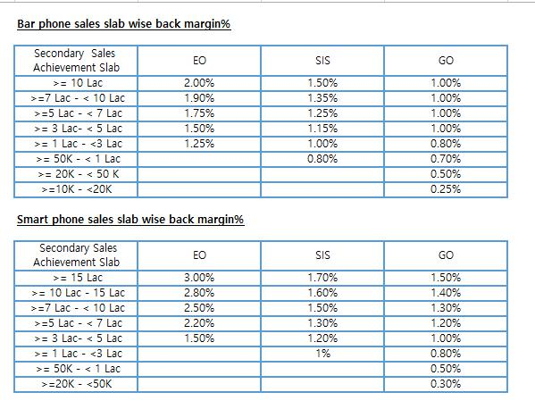
Retail Back Margin _EO
Bar Phone BM Modality
EO will be eligible for 1% back margin in bar phone lifting value. No target will be given to retail for bar phone.
Smart Phone BM Modality
Target Status | Sales Slab | BM % (>= 80% )
Target Based | 30 Lac above | 4.50%
 | 15 Lac - < 30 Lac | 4.00%
 | 7 Lac - <15 Lac | 3.75%
 | 3 Lac - < 7 Lac | 3.50%
Terms & Conditions
Target retail have to achieve >= 80% of given target to avail back margin of Smart phone.
If any retail achievement goes to below slab then incentive back margin % will calculate upon below slab category. If any retail achievement goes to above slab after achieving 120% then incentive back margin % will calculate upon above slab.
120% cap will be applicable for smart phone target retails .For EO in 20 Lac+ slab 120% over achiever will get 2% for additional value. In others slab 120% over achiever will get 1.5% on additional lifting value.
If any retails can’t achieve 80% of given target, will be eligible for 1.5% on lifting value.
Retail have to preserve invoice/sales documentation at least 2/3 months for audit purpose.
Lifting value will be calculated from Symphony ERMS portal. To eligible for incentive retail have to incorporate in the ERMS active retail list.
Retail have to lift product from respective dealer. Cross territory/Cross retail product will not eligible for respective retails back margin.
In case of any audit issue finding, respective retails’ back margin will be held up. After evaluating the disputes, necessary decision will be declared.
Retail back margin will disburse to retail via MFS/dealer payment on Month + 25 working days.
Symphony can update, modify or close the modality any time as per business requirement.

Slide 9
Retail Back Margin _SIS/GO
Bar Phone BM Modality
SIS/GO will be eligible for 1% back margin in bar phone lifting value. No target will be given to retail for bar phone.
Smart Phone BM Modality
Target Status | Sales Slab | BM %
Target Based | >= 5 Lac | 3.00%
 | 3 Lac - < 5 Lac | 2.50%
 | 1 Lac - <3 Lac | 1.80%
Non Target Based | < 1 Lac | 1.00%
Terms & Conditions
Target retail have to achieve >= 80% of given target to avail back margin of Smart phone.
If any retail achievement goes to below slab then incentive back margin % will calculate upon below slab category. If any retail achievement goes to above slab after achieving 120% then incentive back margin % will calculate upon above slab.
120% cap will be applicable for smart phone target retails . 120% over achiever will get 1% on additional lifting value.
If any retails can’t achieve 80% of given target, will be eligible for 1% on lifting value.
Retail have to preserve invoice/sales documentation at least 2/3 months for audit purpose.
Lifting value will be calculated from Symphony ERMS portal. To eligible for incentive retail have to incorporate in the ERMS active retail list.
Retail have to lift product from respective dealer. Cross territory/Cross retail product will not eligible for respective retails back margin.
In case of any audit issue finding, respective retails’ back margin will be held up. After evaluating the disputes, necessary decision will be declared.
Retail back margin will disburse to retail via MFS/dealer payment on Month + 25 working days.
Symphony can update, modify or close the modality any time as per business requirement.

Slide 10
BAR Phone
Itel provide 5 taka/7taka/10taka/15 taka & average 0.97% where as we offer direct 1% for 100% retailers.
We believe it will be help to won retail business attention.

Slide 11

itel Bar phone margin analysis
Model | Status | Retail Front Margin (BDT) | Retail Back Margin (BDT) | Total Margin (BDT)
it2171 | Running | 50 | 5 | 55
it2173 | Running | 50 | 5 | 55
it5022 | Running | 59 | 10 | 69
It5025 | Running | 90 | 10 | 100
It5081 | Running | 90 | 10 | 100
it5606 | Running | 69 | 10 | 79
It5617 | Running | 90 | 10 | 100
it6320 | Running | 100 | 15 | 115
it2191 | Running | 59 | 5 | 64
it5260 | Running | 90 | 10 | 100
it5608 | Running | 70 | 10 | 80
it5618 | Running | 80 | 10 | 90
it6331 | Running | 100 | 10 | 110
it2320 | Running | 60 | 5 | 65
Model | Status | RP
it5022 | Running | 840
it5025 | Running | 960
it5081 | Running | 1060
it5606 | Running | 930
it5617 | Running | 1000
it2171 | Running | 740
it6310 | Running | 1220
it6320 | Running | 1290
it2191 | Running | 840
it5260 | Running | 1000
it2173 | Running | 760
DSR / Salesforce / Market Voice
প্রিয় ব্যাবসায়িক বন্ধু, আসসালামুআলাইকুম।
সিম্ফনি🌙মোবারক ও🌹শুভেচ্ছা।আমাদের ব্যাক মার্জিন পলিসি কেনো সেরা🏋️।আমরা বার ফোনে আপনার জন্য কোনো শর্ত ছাড়াই 🆓নিয়ে এসেছি 🏧 ১% কমিশন পলিসি। অর্থাৎ
আমাদের📱 বি১২,📱বি ২৪ যে কোনো পছন্দের বার ফোন তুলুন সরাসরি🌈 ১% কমিশনে।কিন্তু উদাহরণ স্বরূপ itel মডেল ২১৭১ যার ক্রয় মূল্য ৭৪০ টাকা,এই হ্যান্ডসেট টি ব্যাক মার্জিন ৫ টাকা অর্থাৎ কমিশন মাত্র ০.৬৭% যেখানে সিম্ফনি অফার💞 ১%।
ব্র্যান্ড শপ স্মার্ট ফোনে সর্বাধিক ৪.৫% ও এস আই এস এবং জেনারেল আউটলেট জন্য সর্বাধিক বহুল প্রত্যাশিত 🆕 ৩% কমিশন।আশাকরছি আপনাকে 🇧🇩সিম্ফনি🇧🇩 ব্যাবসায়িক ভাবে লাভবান করতে বরাবরের মত 💯💯 সফল👌।আপনার আরো অধিক ব্যাবসায়িক উন্নতি📝 কামনা করছি। ধন্যবাদ।

Slide 12
Smart phone Margin analysis (close brand)
Brand: | itel
Channel | Segment | Front Margin | Back Margin Criteria | Back Margin | Remarks | Max. Margin | Min. Margin
Retailer | Smart | 6.95% | 1-4 | 1.0% |  | 9.95% | 6.95%
 |  |  | 5-9 | 1.5%
 |  |  | 10-30 | 2.0%
 |  |  | 31-50 | 2.5%
 |  |  | 51+ | 3.0%
Symphony new margin strategy: (Front+ Back): GO/SIS 7.5%+3%= 10.5%
Symphony new margin strategy: (Front+ Back): E0: 7.5%+4.5%= 12%
SBC Outlet voice: (Front+ Back): SBC Outlet: 4% costing then SIS:10.5% + 4%= 14.5% EO:12%+4%= 16%

Slide 13
Thank You

